Slide 1
ISTIO - Testing
Evgeniy stoyanov
Alex PLETNEV

Slide 2
Fallacies of Distributed Systems
The network is reliable
Latency is zero
Bandwidth is infinite
The network is secure
Topology doesn't change
Transport cost is zero
The network is homogeneous

Slide 3
Chaos Engineering

Slide 4
Reality
Even when all of the individual services in a distributed system are functioning properly, the interactions between those services can cause unpredictable outcomes. Unpredictable outcomes, compounded by rare but disruptive real-world events that affect production environments, make these distributed systems inherently chaotic.

Slide 5
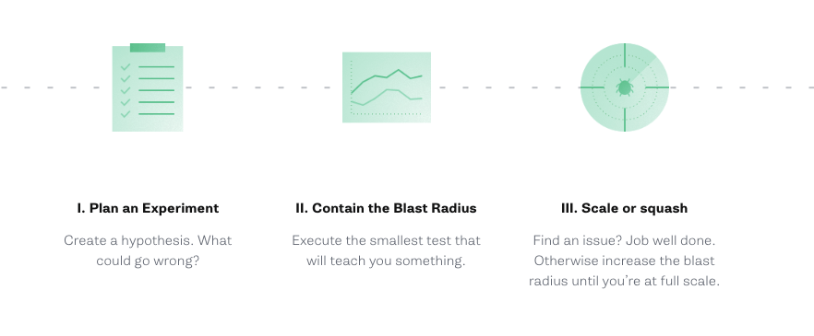
PRINCIPLES OF CHAOS ENGINEERING

Slide 6
First chaos experiment
Step 1 – Define the normal state of the system based on the measurable output such as throughput or latency.
Step 2 – Choose a failure to inject, and hypothesize what you think will go wrong – what will be the impact on your service, system, and customers?
Step 3 – Isolate an experimental group, and expose that group to a simulated real-world event, such as a server crash or traffic spike.
Step 4 – Test the hypothesis by comparing the normal state of the control group against what happened in the experimental group.

Slide 7
Istio Fault Injection

Slide 8
Istio - Fault Injection
Http fault
Delay fault

Slide 9
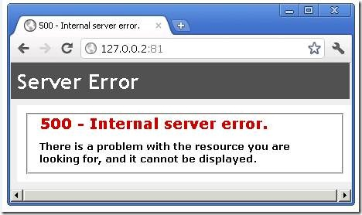
Http fault

Slide 10
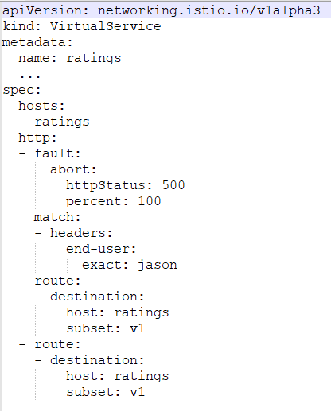
Http fault

Slide 11
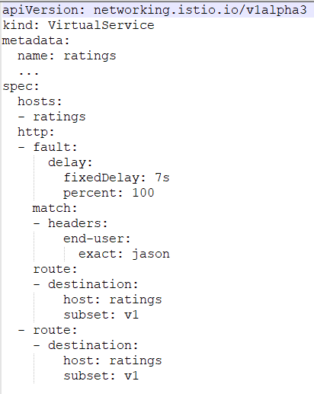
Delay fault

Slide 12

Questions?

Slide 13
Homework
Task: istio testing
Instructions: in attachments

